Slide 1

Lab 11: Programmed Logic Arrays
CSE 2301 – Fall 2024

Slide 2
Introduction: Programmable logic array
In this lab we will study PLA applications in LogicWorks.
The emphasis of this lab is to tie together some concepts from throughout the course.

Slide 3
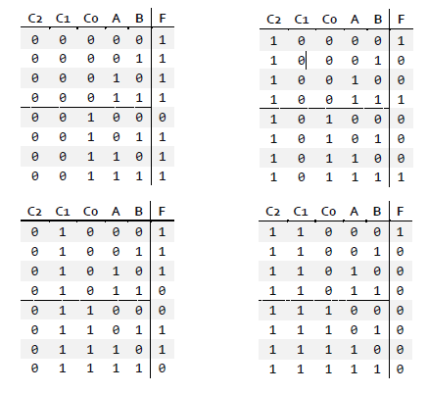
Part 1: the hard way
It’s what you’ve been doing all semester. We’re going to hand you a large table and you’ll have to fill out a 5-variable K-map to complete it.
Find the equation and built it in LogicWorks.

Slide 4
Part 2: The easy way
Now that you’ve refamiliarized yourself with the tedium or part 1, we’re going to do something similar, but with far less hassle.
By building a PLA in LogicWorks, we can avoid reducing an equation and building a circuit for it. Instead, we’ll simply define the unreduced minterms where the output is high.

Slide 5
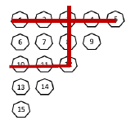
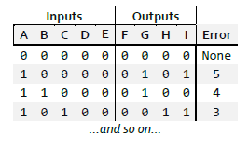
Part 3: Triangular Parity
Create one PLA which takes as input 5 check bits and spits out the position of the error for a triangular parity code.
Your task is to define the FGHI (weighted 8-4-2-1) output for an ABCDE (5 independent check bits)
You’ll first create a table for all the outputs by studying the code, then create the PLA by finding the minterms (no reduction needed!) for each output bit.

Slide 6
Part 3: Triangular Parity [2]
When you go to create your PLA, it’s critical that you describe [5] input lines and [4] output lines.
After that, you’ll be asked to enter product terms (minterms) for each bit. Enter the ABCDE binary codes where that bit is ‘1’, separating by newlines.
5
4

Slide 7

Other notes AND report information
More detailed instructions for the PLA wizard are included in the lab instructions.
There is no demo for part 2, just parts 1 and 3.
Since we’re nearing the end, the questions on this lab report will be taken from throughout the semester.

